Slide 1
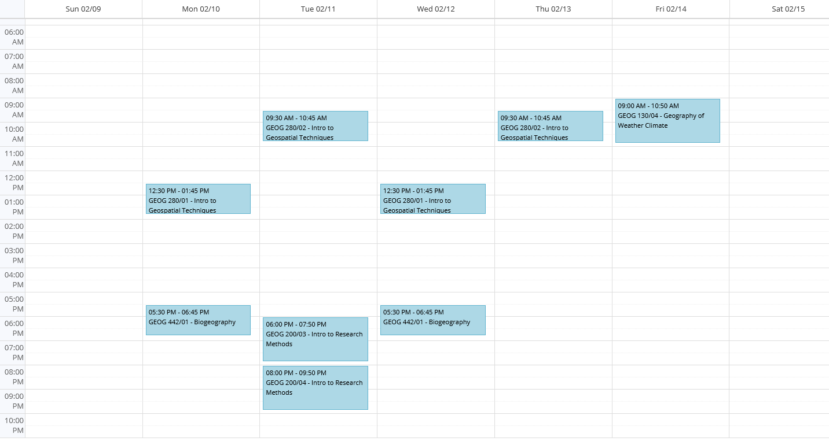
PH1-208 Open Lab Schedule – Spring, 2020
Sunday
Monday
Tuesday
Wednesday
Thursday
Friday
Saturday
Open Lab
9:00am-12:30pm
(Segnide)
Open Lab
9:00am-12:30pm
(Darrell)
Open Lab
10:45am-2:00pm
(Segnide)
Open Lab
10:45am-2:00pm
(Segnide)
Open Lab
10:45am-3:00pm
(Neysha)
Open Lab
1:45pm-5:00pm
(Darrell)
Lab Maintenance
Open Lab
1:45pm-5:00pm
(Neysha)
Open Lab
2:00pm-5:00pm
(Neysha)
Open Lab
3:00pm-8:00pm
(Darrell)

